Slide 1

Dermalyze: Deep Learning-Driven Dermoscopic Analysis for Early Skin Cancer Detection
Presented By:
ABOUHANE Zahra, BAZGOUR Yassine
Evaluated By:
Hajar Mousannif, Mohammed-Amine Chadi
https://www.flaticon.com/search?word=data

Slide 2
Problematic
01

Slide 3
135,860
Number of skin cancer deaths worldwide ( 2020 )
https://www.cancertherapyadvisor.com/news/non-melanoma-skin-cancer-deaths-exceed-melanoma-deaths-globally/

Slide 4
Aim
02

Slide 5

Telemedicine System

Slide 6
System Architecture
03

Slide 7





Prediction &
Confidence
If Normal
Image
Age
Gender
Skin Region
Encode
Data
User
Interface
Binary
Classification
Model
If Abnormal
Cancer Type
Multi
Classification
Model
Cancer Type &
Confidence

Slide 8
Data
04

Slide 9
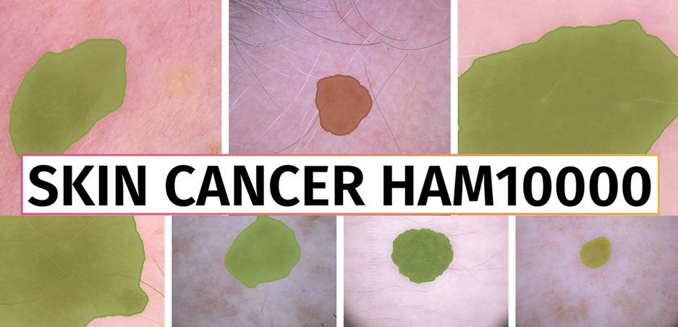

Slide 10
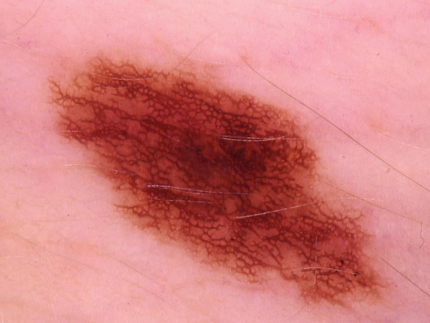
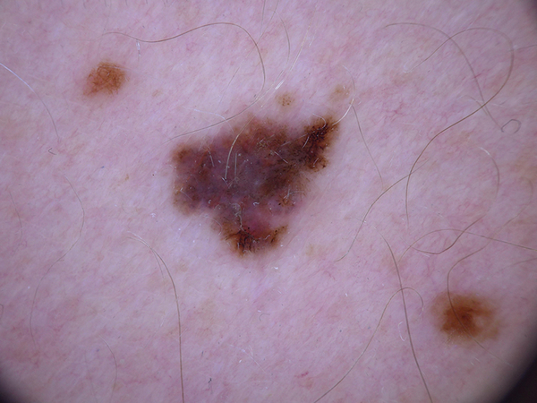
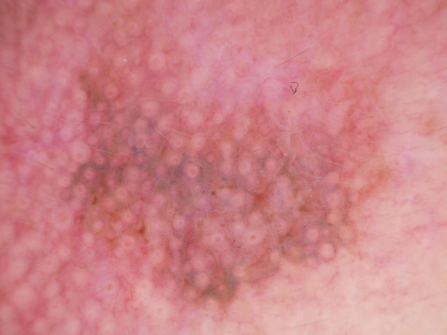
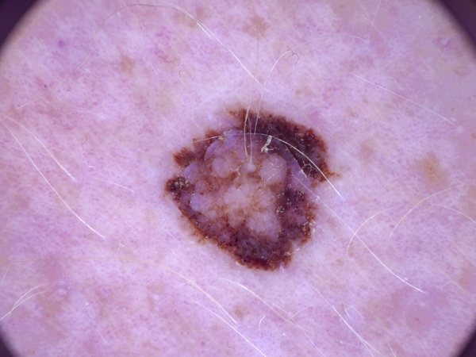
Smaples From The Dataset

Slide 11
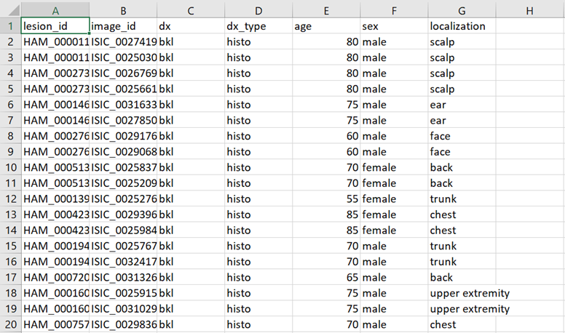
Chunk From Metadata.csv

Slide 12
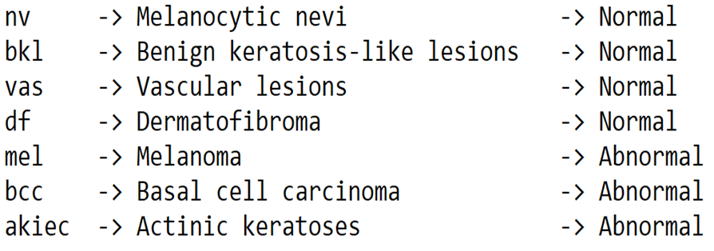
Lesion Types Description

Slide 13
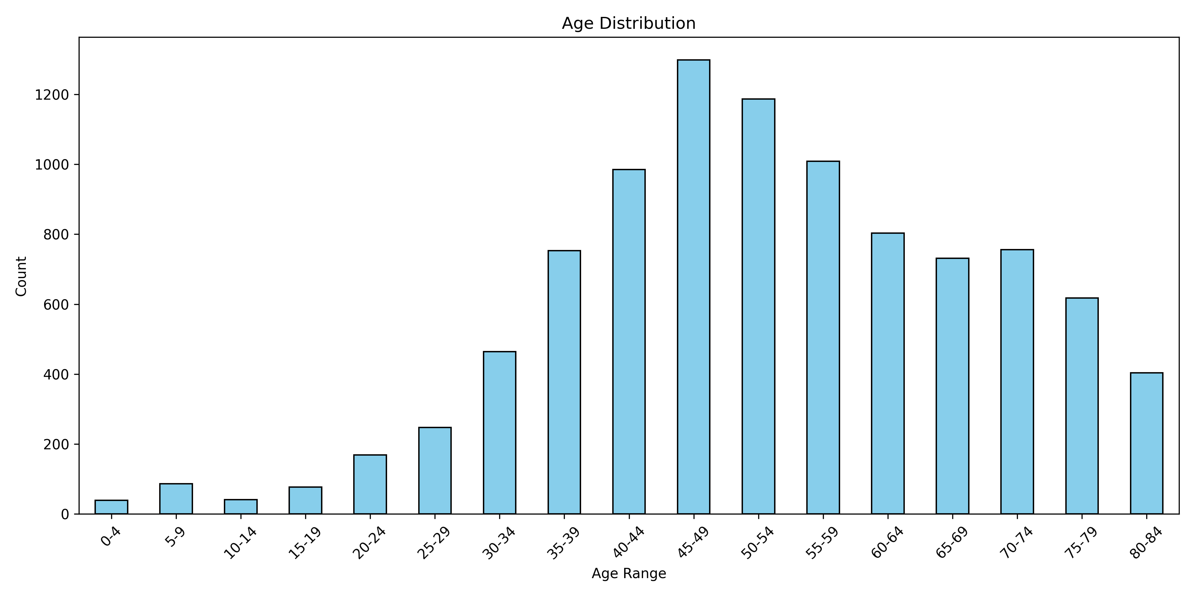

Slide 14
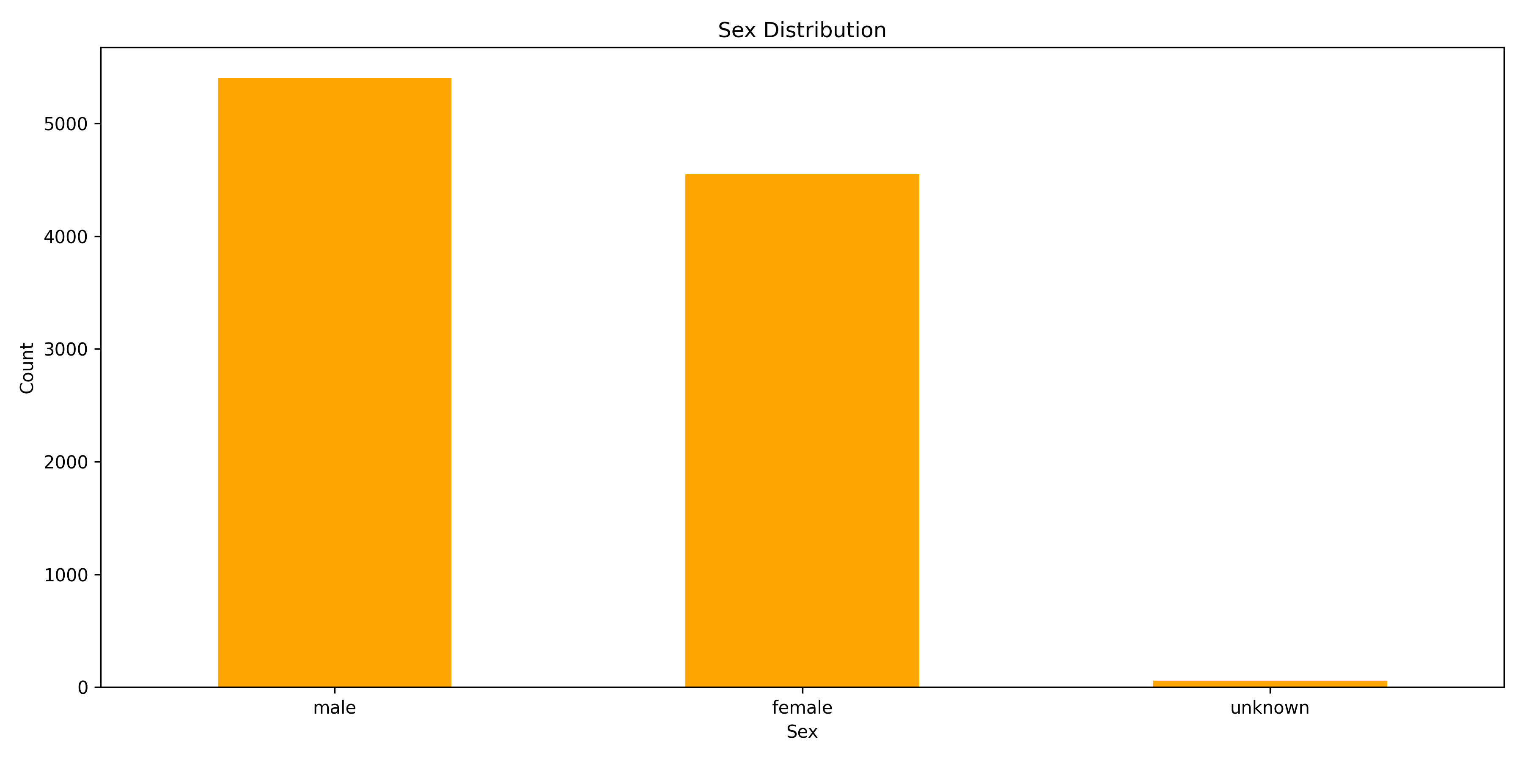

Slide 15
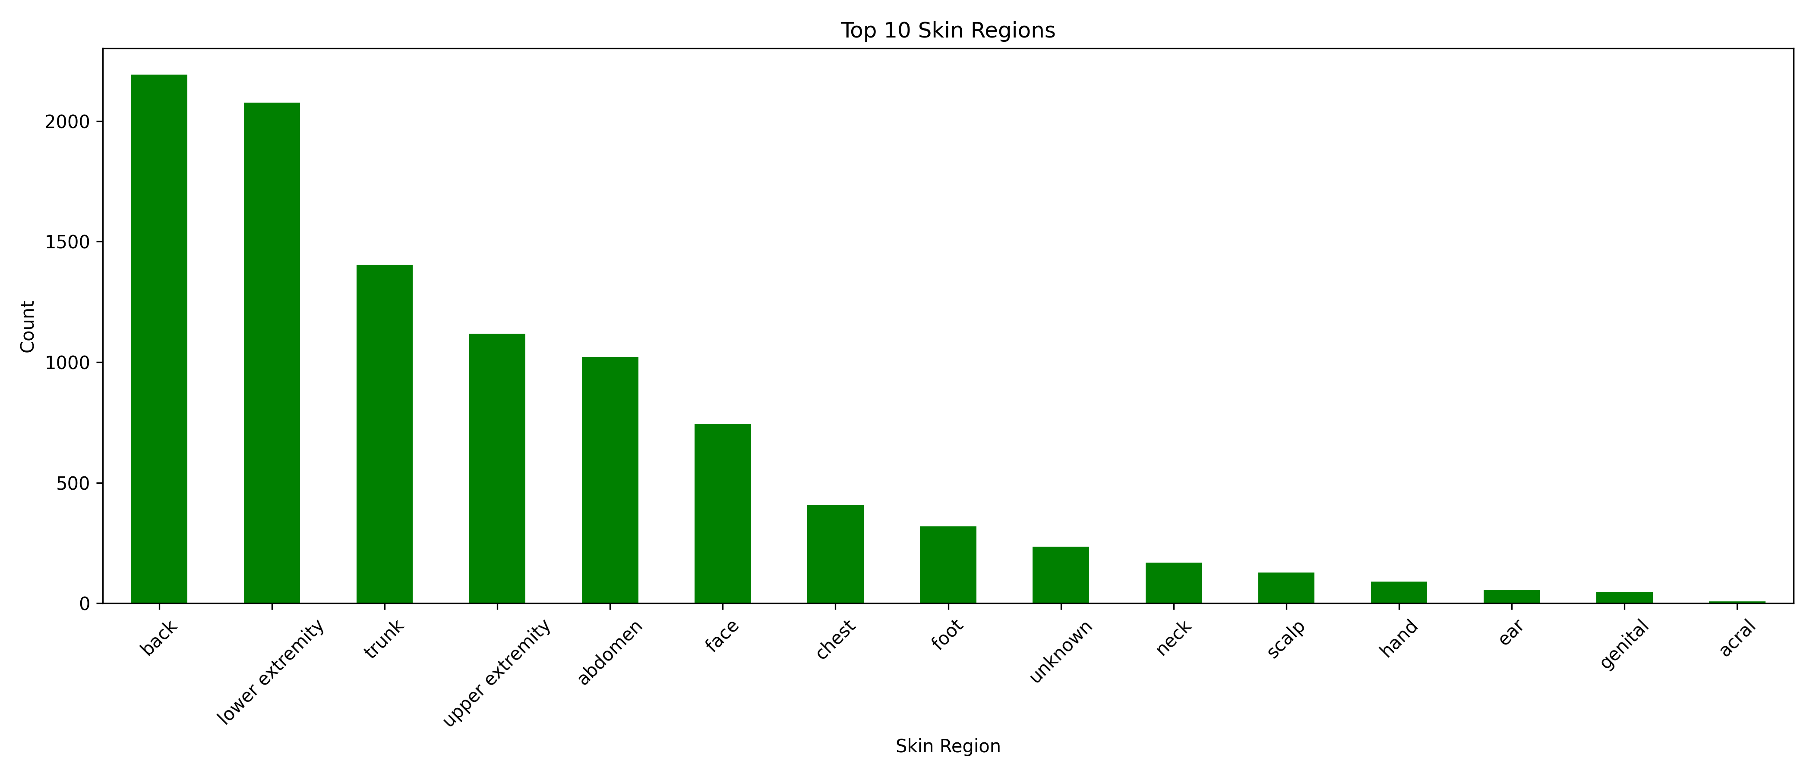

Slide 16
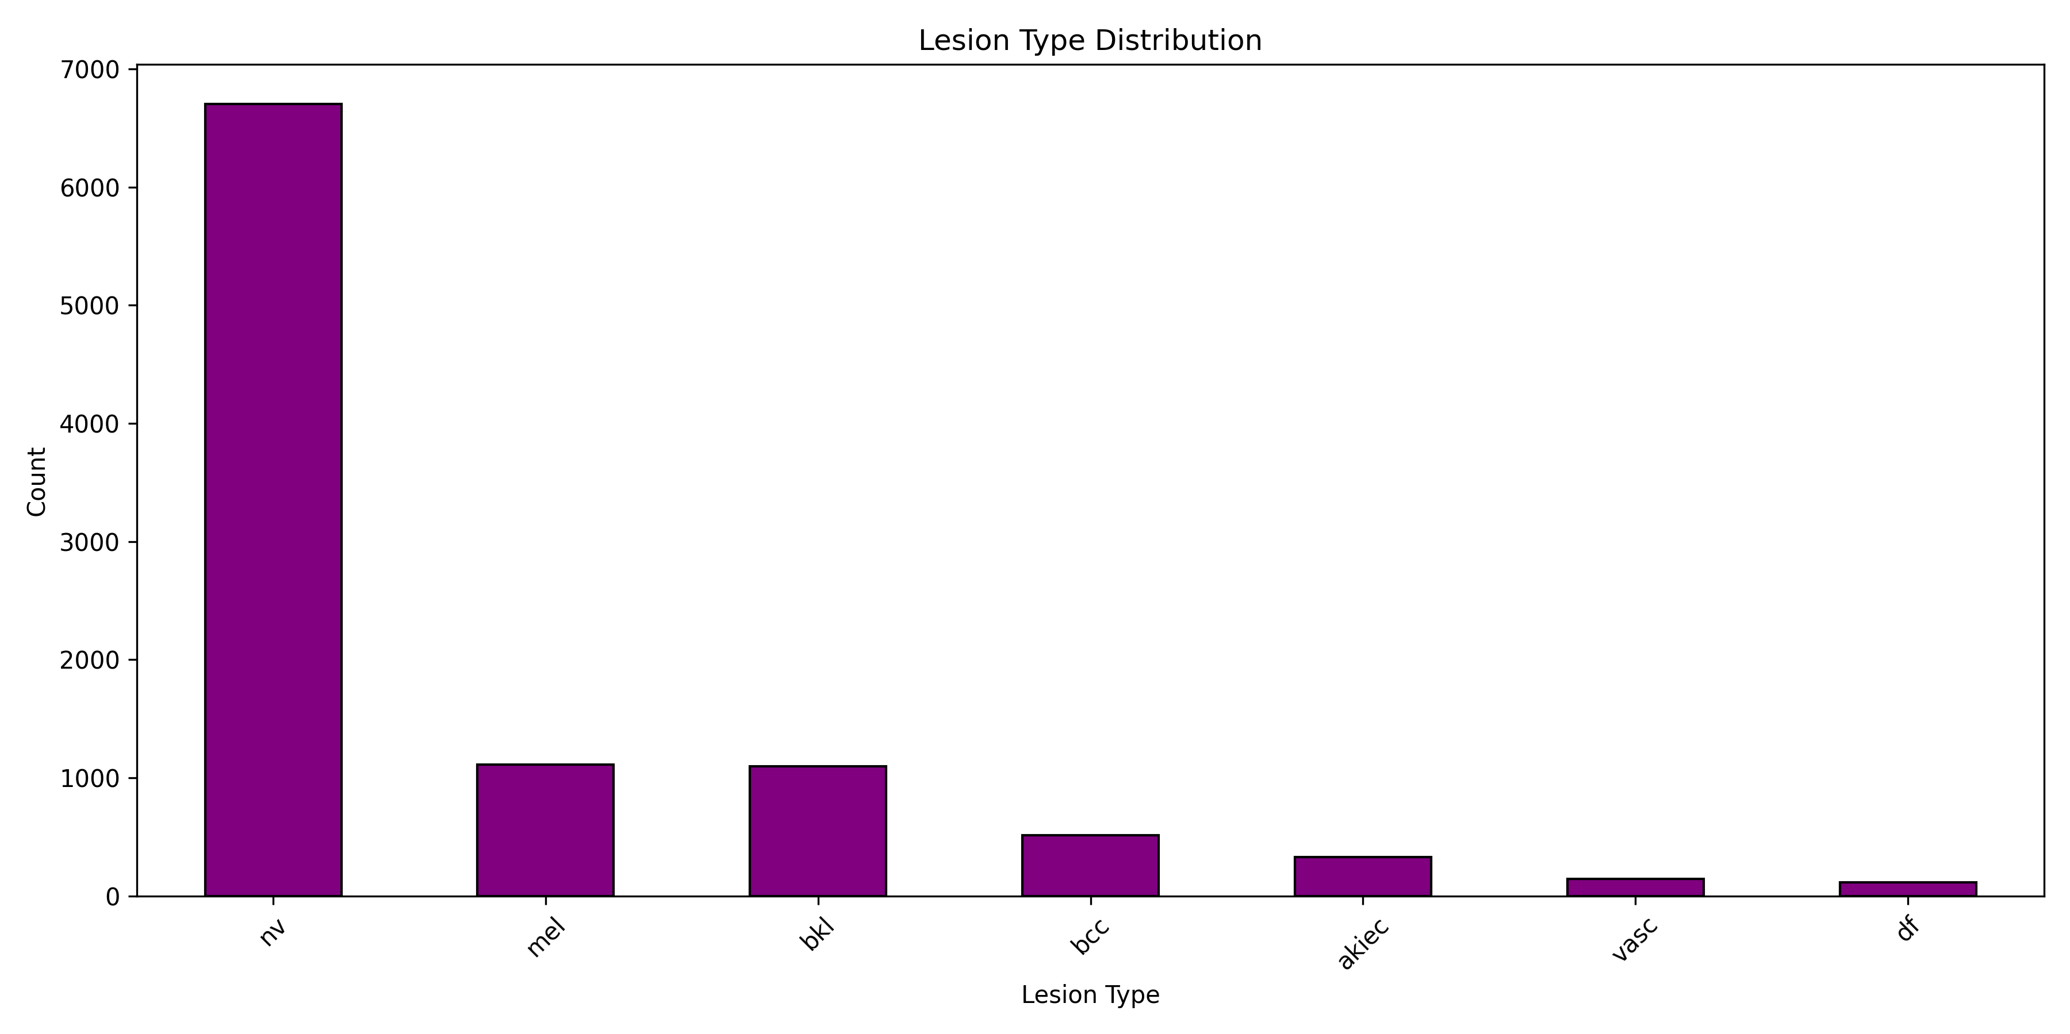

Slide 17
10,015 images
7 diagnostic categories | 4 Normal | 3 Abnormal
Patient Metadata: age | gender | Location
High-resolution images
Class imbalance with nevi as majority class
Labels confirmed by pathology | expert consensus
Widely used benchmark for skin lesion classification models

Slide 18


Binary Skin Classifier Data
Multi Skin Classifier Data
Before: 7 Classes
Abnormal Classes: 1945 Images
Normal Classes: 8061 Images
After: 2 Classes
Abnormal Class: 1954 Images
Normal Class: 1955 Images
Before: 7 Classes
Abnormal Classes: 1945 Images
Normal Classes: 8061 Images
After: 3 Classes
mel: 1113 Images
bcc: 514 Images
akiec: 327 Images

Slide 19
Model
05

Slide 20
EfficientNetV2B0
India 2025
https://ieeexplore.ieee.org/abstract/document/10912377
Accuracy: 96% | Recall: 100%
India 2024
https://ieeexplore.ieee.org/abstract/document/10533983
Accuracy: 98% (ISIC) 99% (HAM)
Saudi Arabia 2022
Accuracy: 99% (Detection) Accuracy: 99% (Classification)
https://www.mdpi.com/2072-6694/14/23/5872

Slide 21
EfficientNetV2B0
Input Size: 224 × 224 × 3
Parameters: 7,184,897
Size: 7,184,897 (parameter) x 4 (byte) = 27.4 (Mb)
FLOPs: ~0.98B
Depth: 237 layers
Training Speed: Faster than EfficientNetV1 due to fused MBConv blocks

Slide 22
Interface
06

Slide 23




Technologies Used
HTML
Javascript
CSS
Python
Backend
Frontend

Slide 24
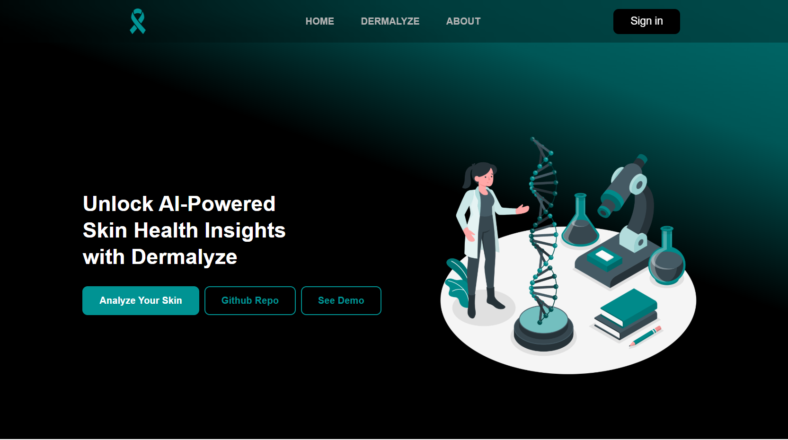

Slide 25
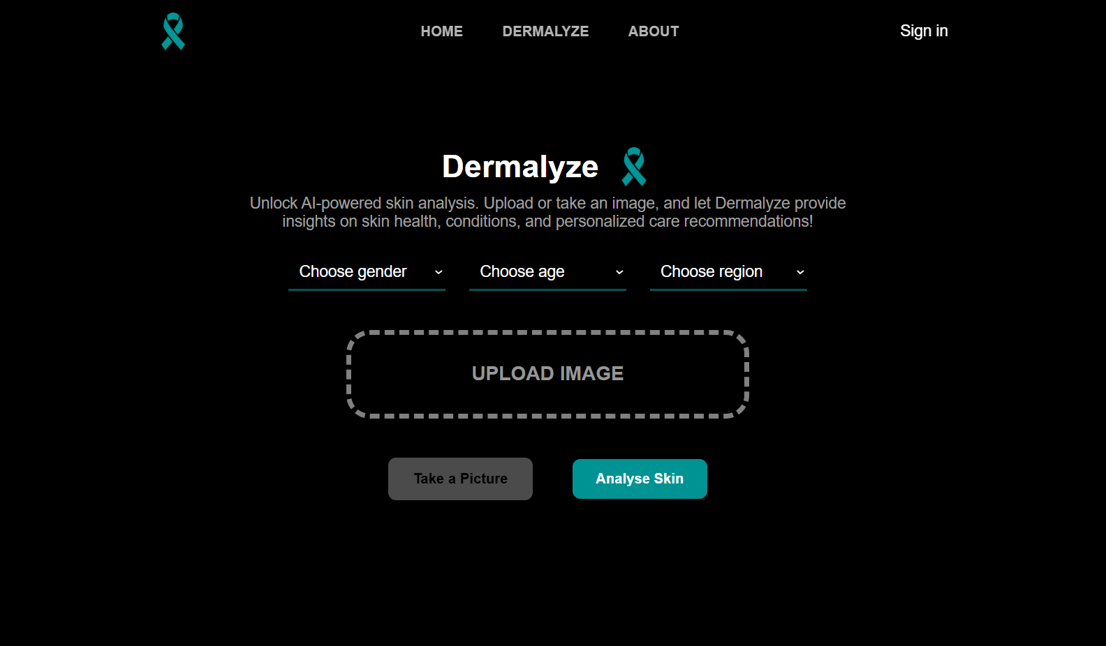

Slide 26
Results
07

Slide 27
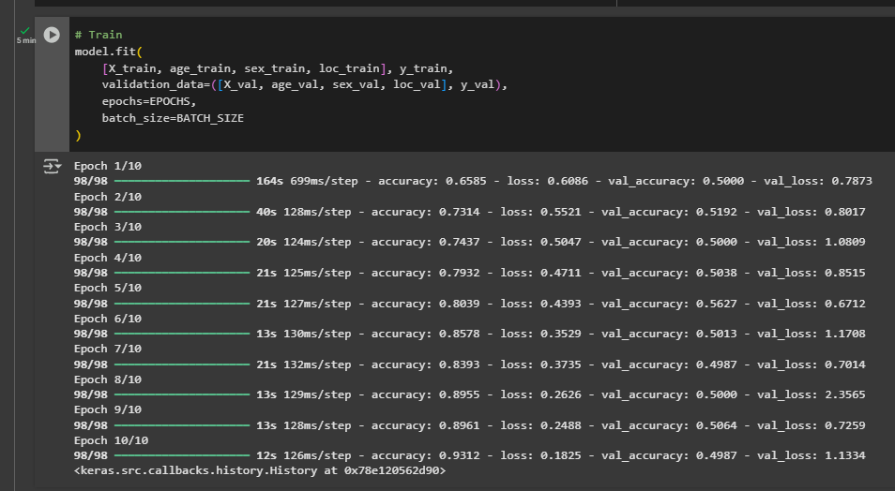

Slide 28
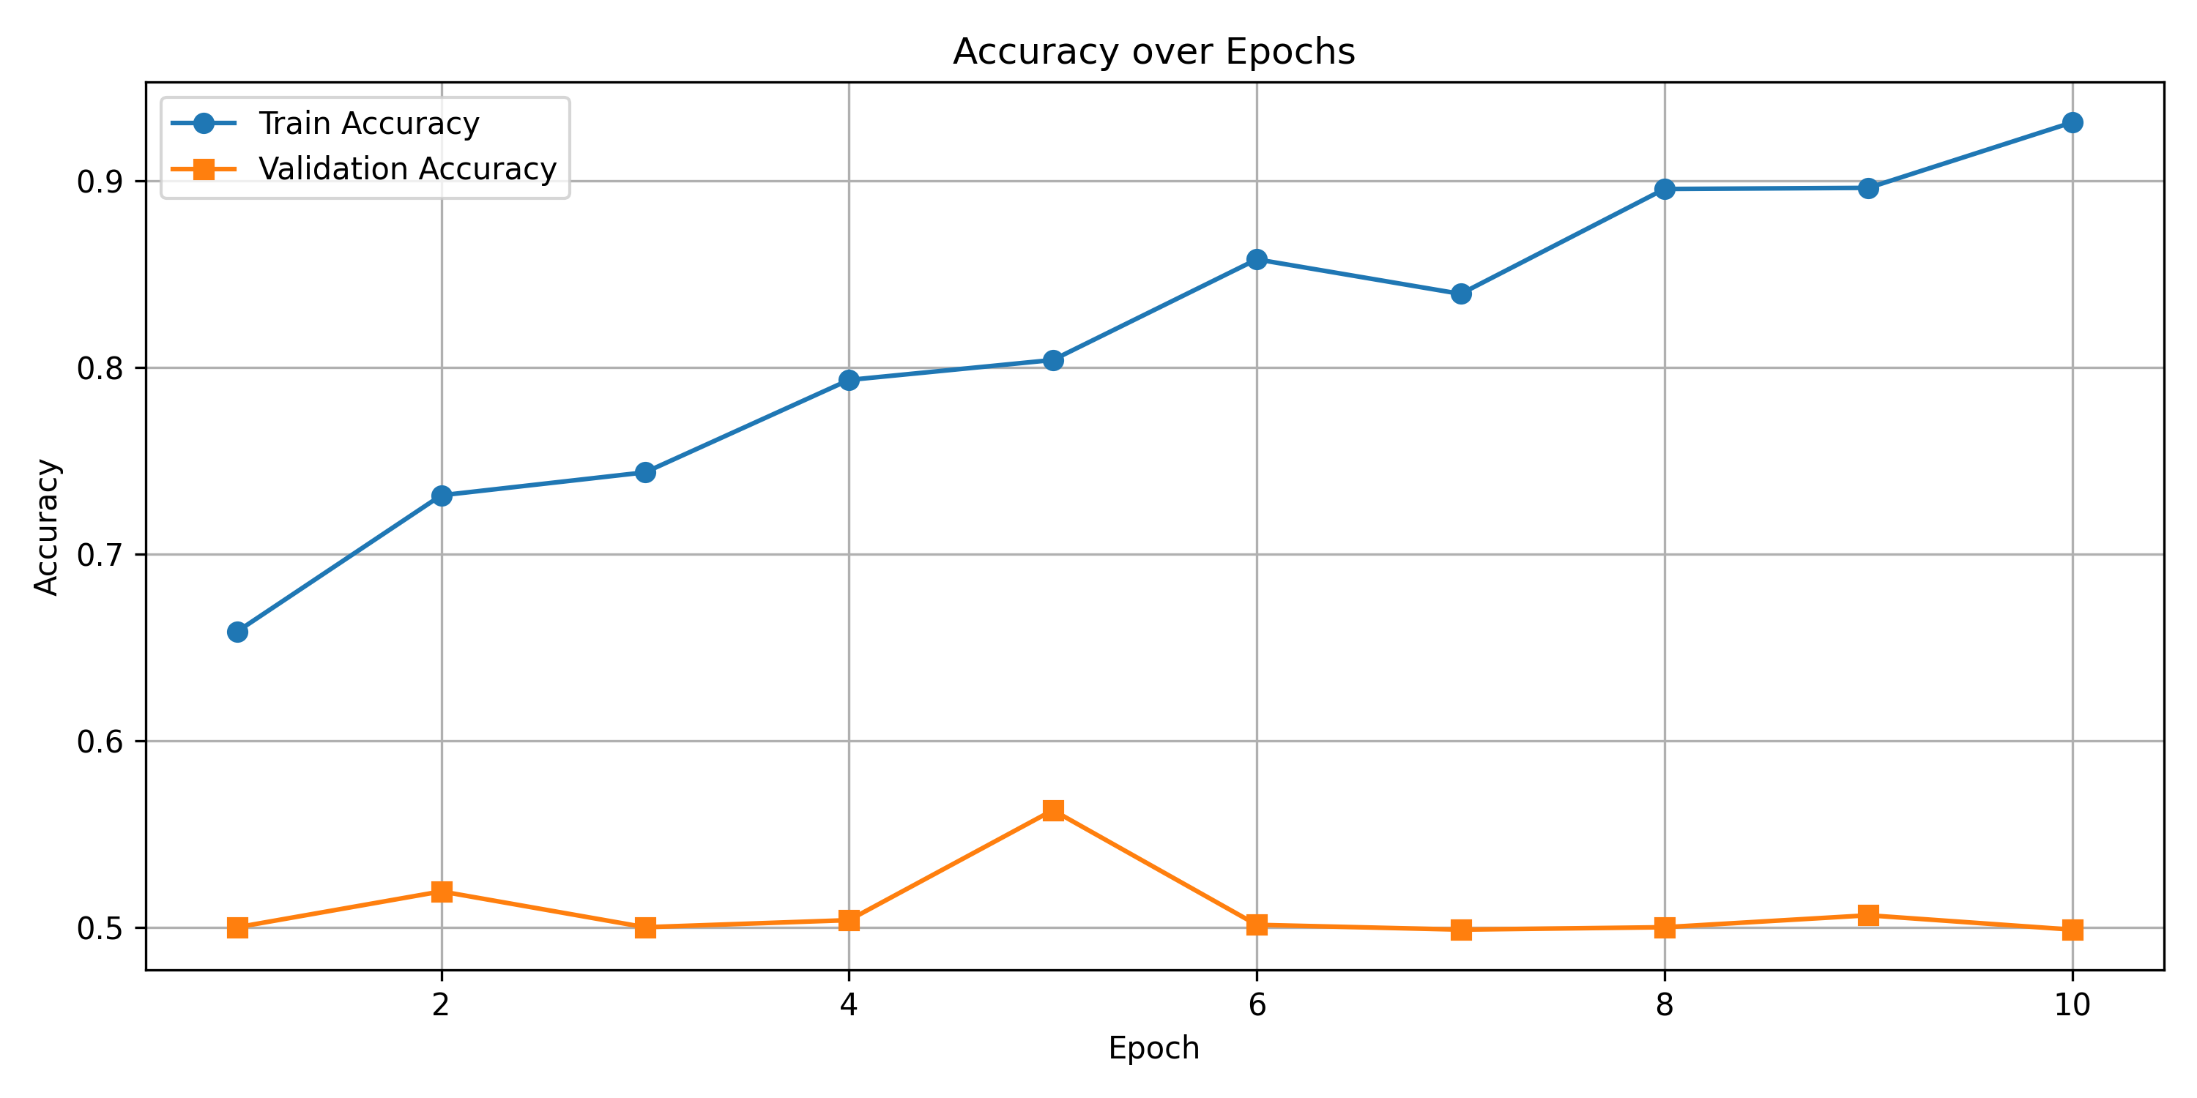

Slide 29
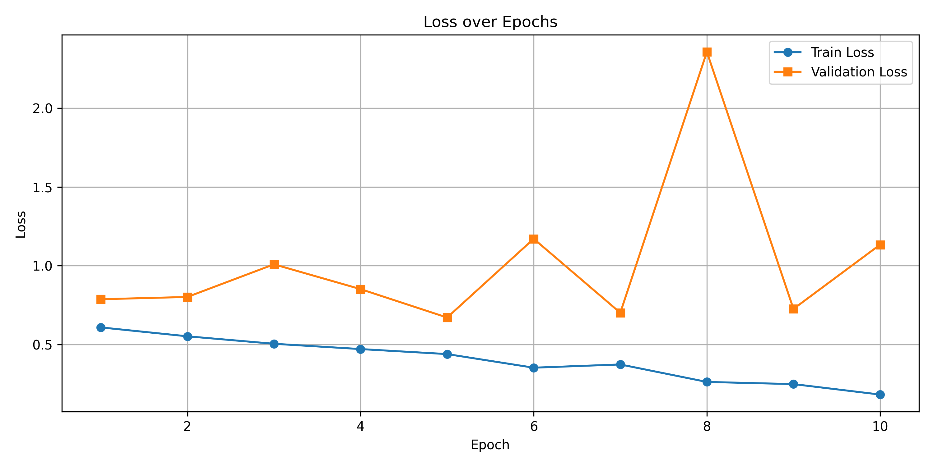

Slide 30
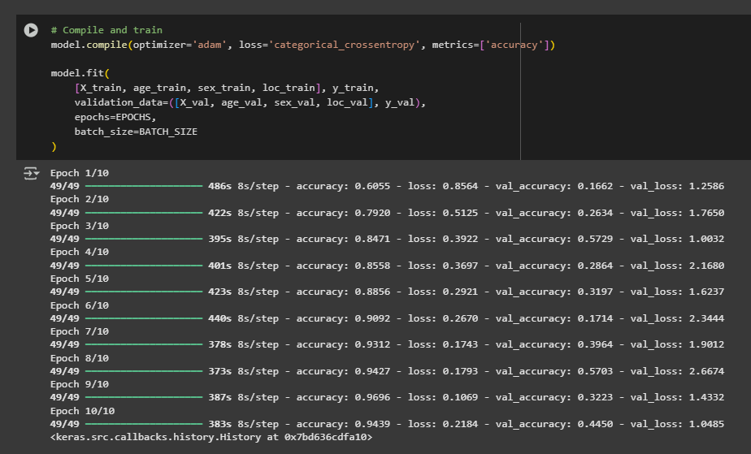

Slide 31
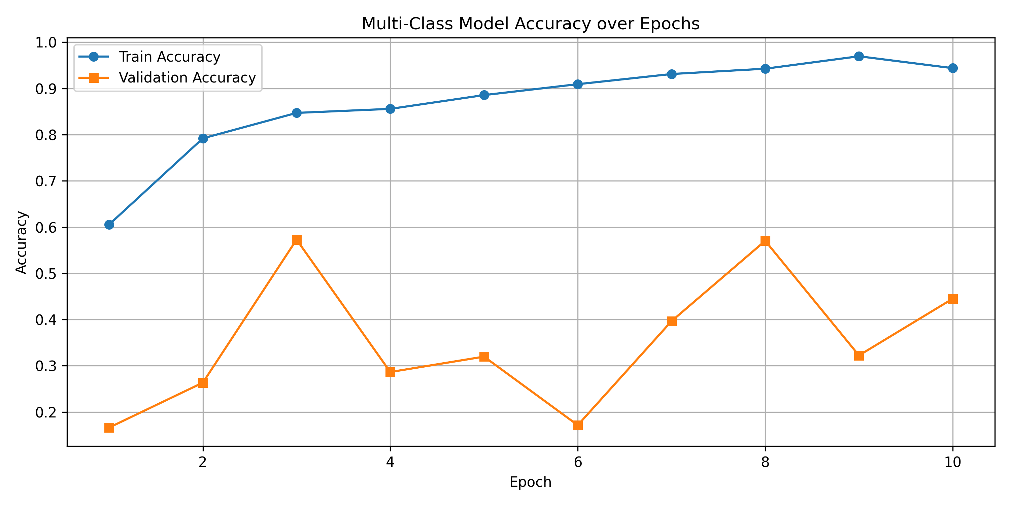

Slide 32
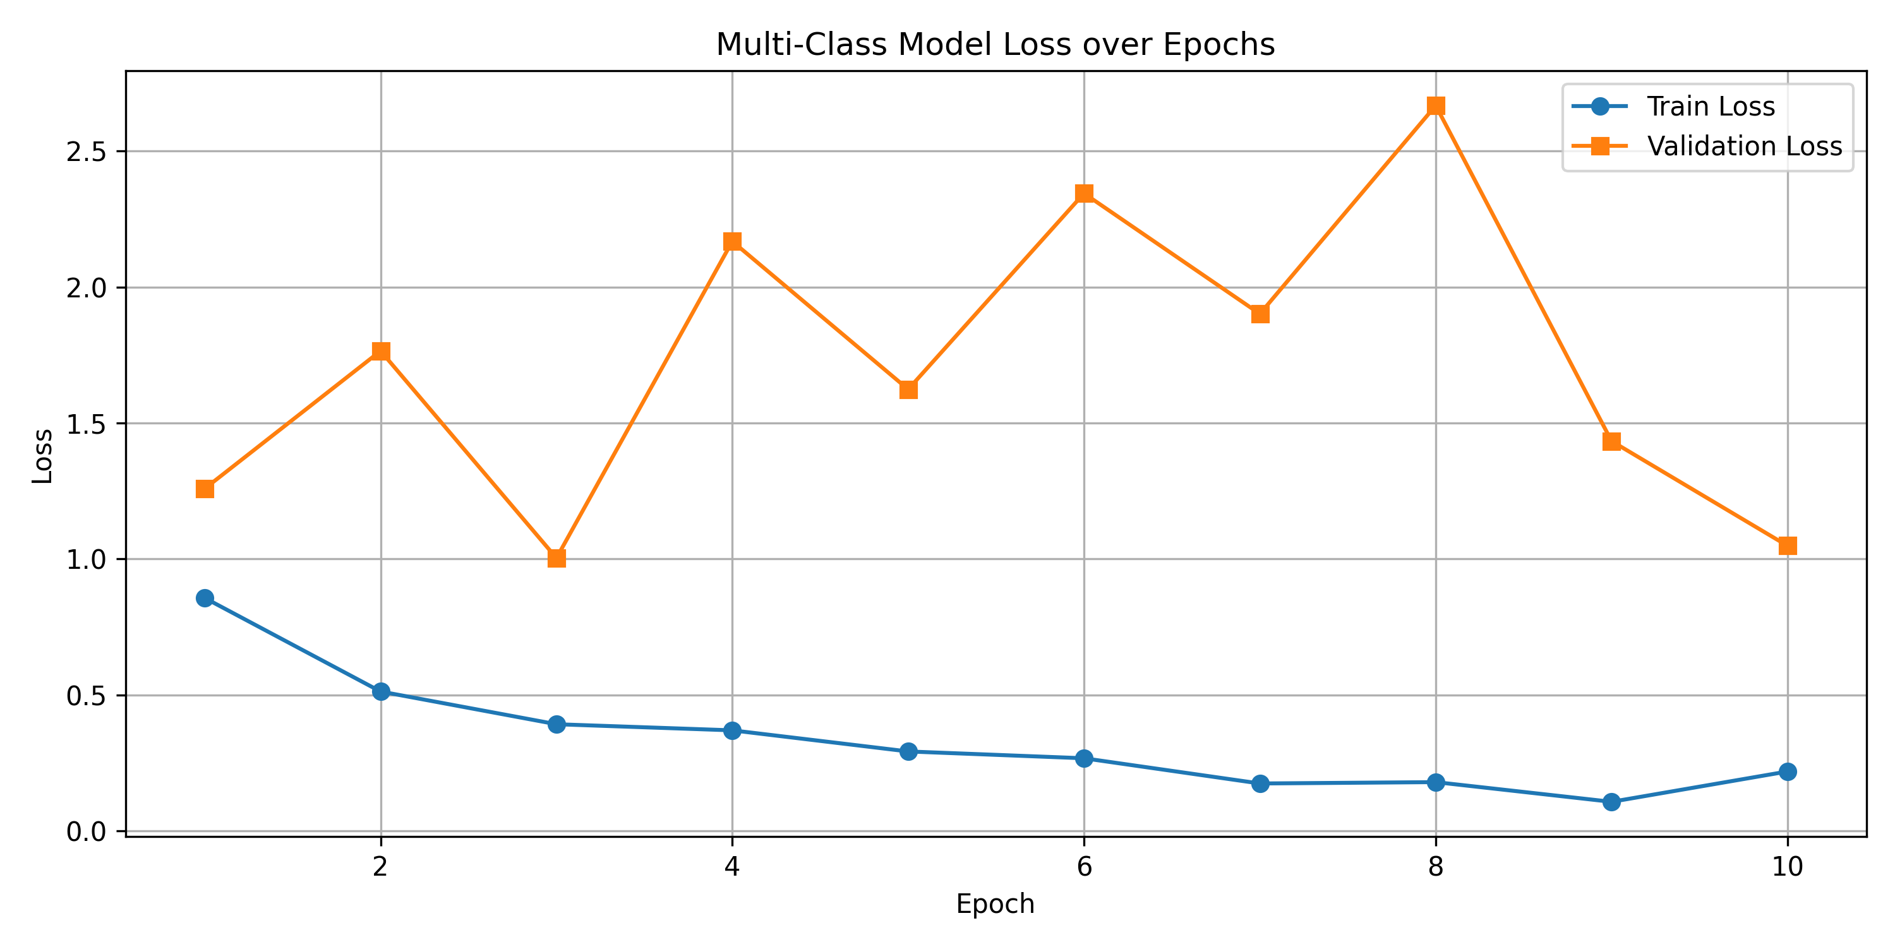

Slide 33
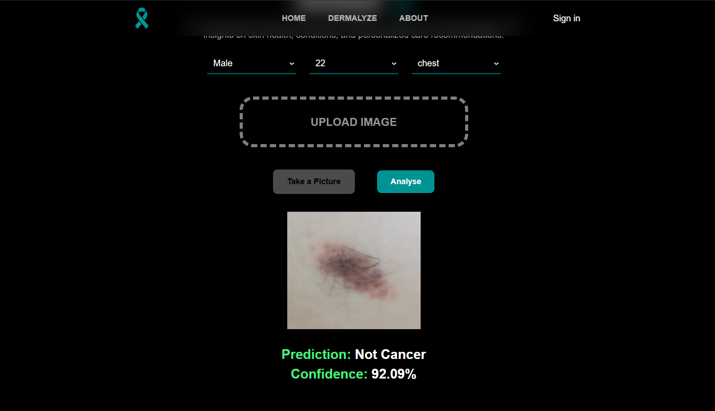

Slide 34
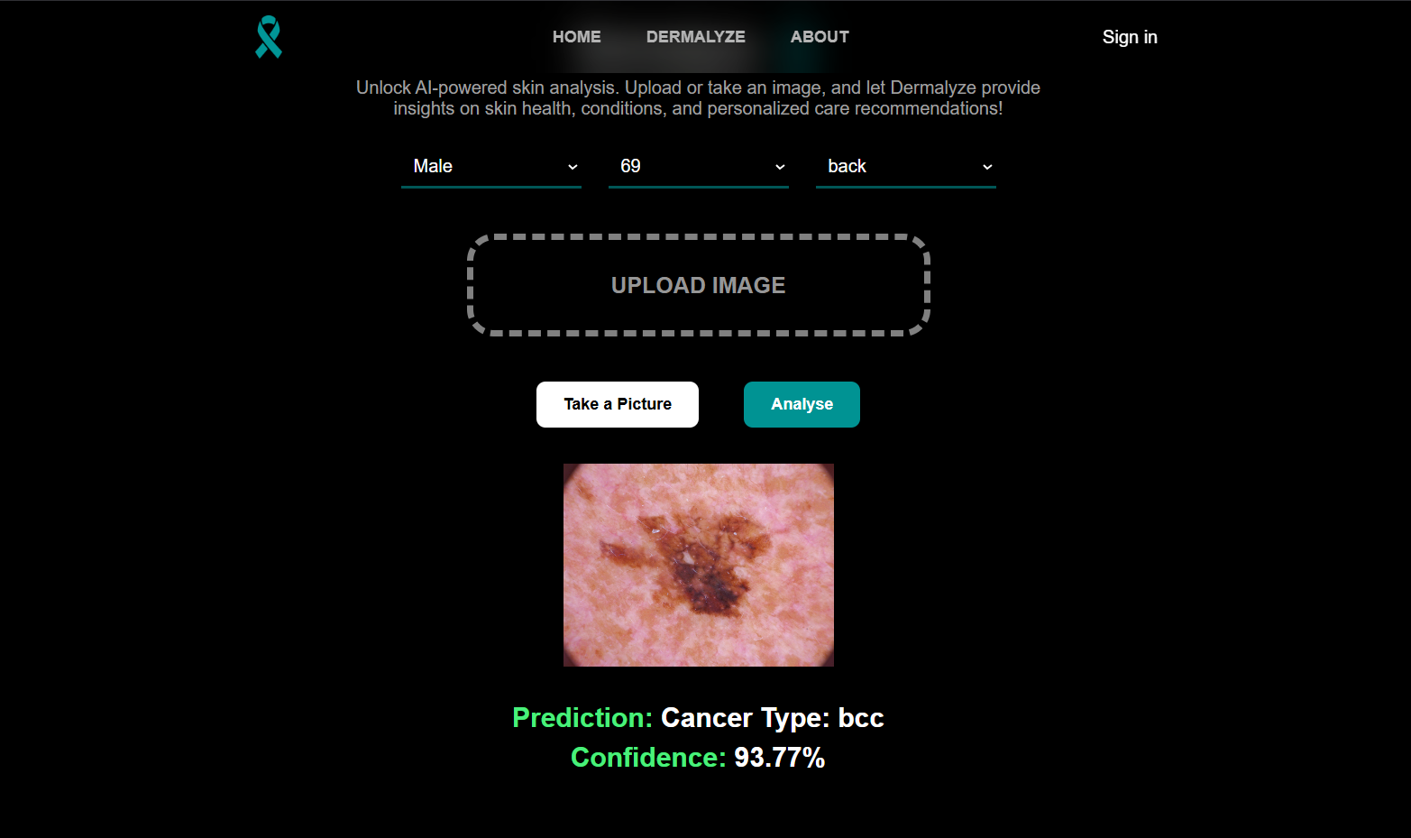

Slide 35
Demo
08

Slide 36
Discussion
09

Slide 37



Benefits
Early Detection Cancer
Accessible to Everyone Through Mobiles
Multi-Input Learning

Slide 38


Limitations
Lack of Clinical Validation
Poor Generalization

Slide 39
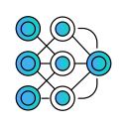

Future Work
Test Other Pretrained Models
Enlarge Dataset and Improve its Quality

Slide 40

Thank You

